Slide 1
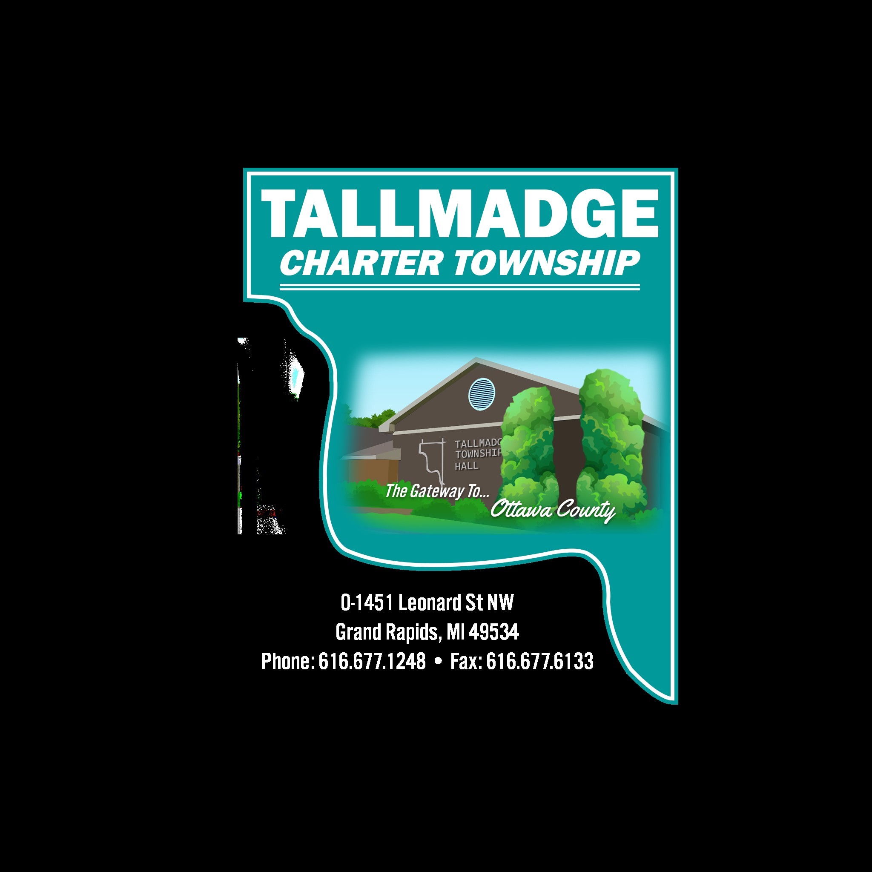
budget recommendation
FY 2024-25

Slide 5
Possible Projects FY 2024-2025

