Slide 1
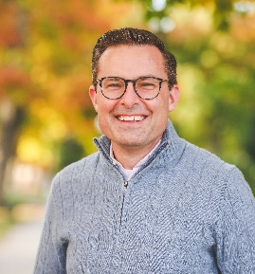
Property Fraud Alert
Justin F. Roebuck
Ottawa County Clerk/Register of Deeds

Slide 2
Property & Mortgage Fraud
According to the FBI, property and mortgage fraud is the fastest growing white-collar crime in the U.S.
Mortgage Fraud for Profit.
Usually committed by industry insiders using their specialized knowledge or authority to commit fraud.
Mortgage Fraud for Housing.
Typically represents illegal actions conducted solely by the borrower, who misrepresents income and asset information on a loan application.

Slide 3
Property & Mortgage Fraud
Deed Fraud
Targets senior citizens and absentee owners
Record false deeds to the property
They may live there
They may rent out the property
They may take out numerous mortgages leaving the real owner holding the debt

Slide 4
Property Fraud Alert
What Doesn’t It Do?
Prevent fraud from happening
What Does It Do?
Informs you when a document has been recorded in your name
Allows you to be proactive and take appropriate steps if you believe fraud has occurred

Slide 5
General Information
Property Fraud Alert is a free automated service
Will monitor your name to assist you in tracking fraudulent activity
Customizable-you choose how to be notified
Email
Phone
Text

Slide 6
Ottawa County Residents Sign Up Now
Visit PropertyFraudAlert.com or call 800-728-3858.
Free
Simple

Slide 7
For more information or questions, please contact us!
Justin F. Roebuck
Ottawa County Clerk/Register of Deeds
(616) 994-4537
jroebuck@miottawa.org
Rachel Sanchez
Chief Deputy Register of Deeds
(616) 994-4518
rsanchez@miottawa.org
Register of Deeds Office
(616) 994-4510
register@miottawa.org

